Slide 2
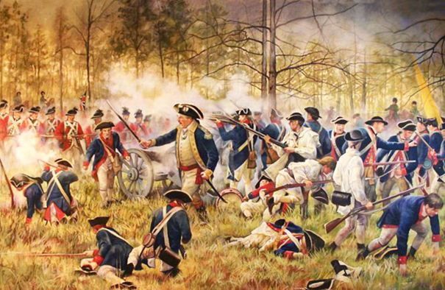
© Rosie's Resources, LLC

Slide 3
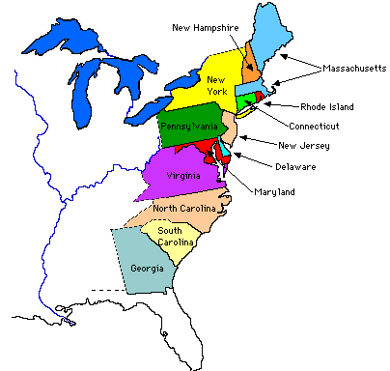
The Thirteen Colonies
By the mid 1700s, there were thirteen thriving English colonies in North America.
© Rosie's Resources, LLC

Slide 4
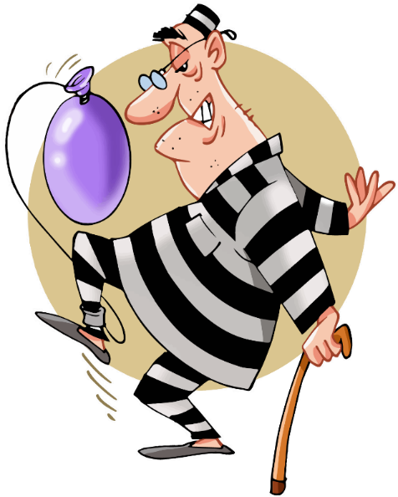
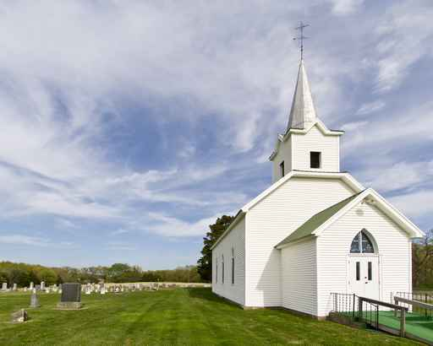
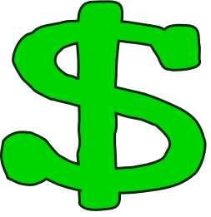
These are the reasons free people came to America.
Religious Freedom
Economic Gain
To avoid debtors’ prison
In America, people worked hard and enjoyed their freedoms.
© Rosie's Resources, LLC

Slide 5
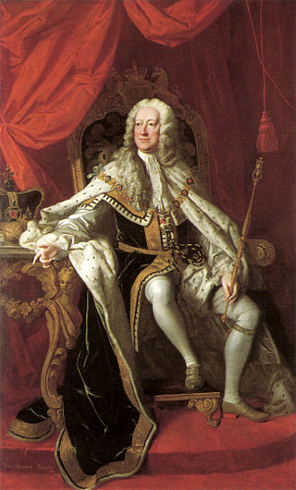
For nearly 150 years, England ruled over the American colonies, and the colonies prospered. However, British troops became more and more involved with the colonies. The colonists began to worry they would lose their freedoms.
King George II, 1727 - 1760
© Rosie's Resources, LLC

Slide 6
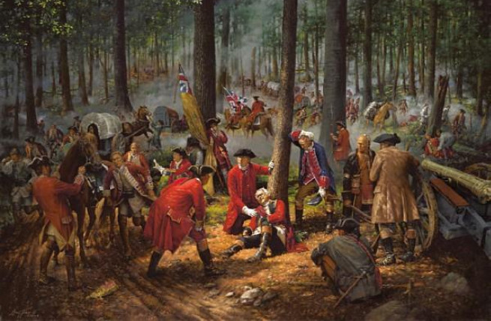
England fought a long war in North America against the French and their Native American allies. This became known as the French and Indian War. It lasted over seven years. The English won the war, but it was very expensive!
The French and Indian War
© Rosie's Resources, LLC

Slide 7
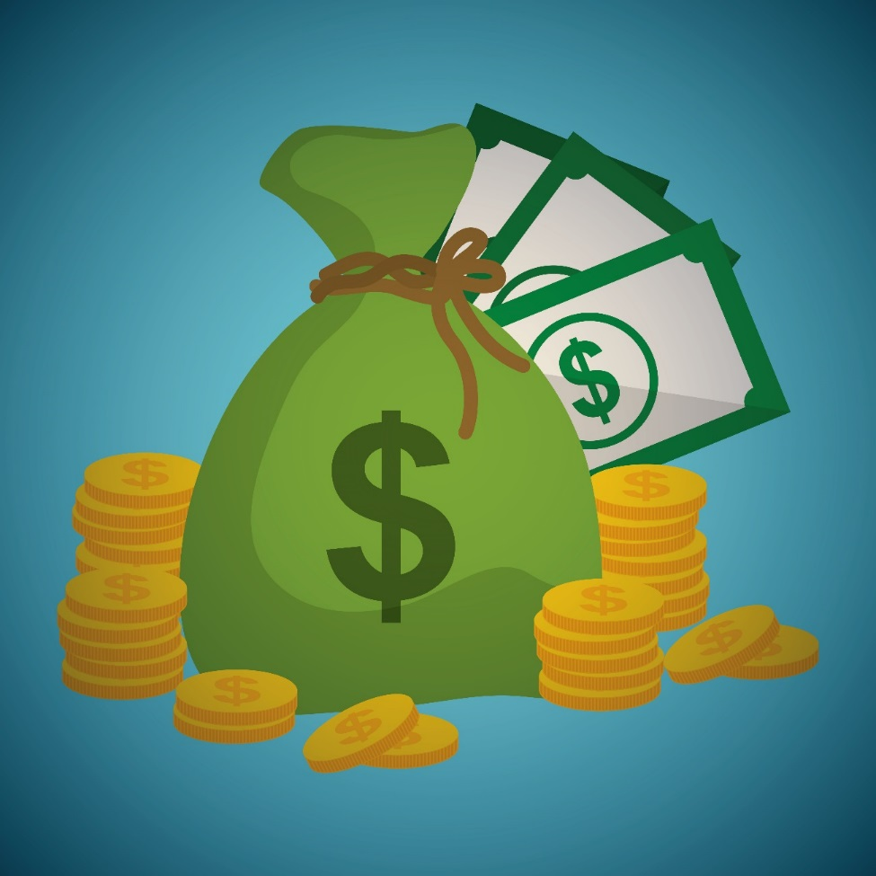
England imposed a tax on the American colonists to pay for the French and Indian war. The colonists thought this was very unfair. They did not even have a chance to vote on the tax! They called this “taxation without representation.”
© Rosie's Resources, LLC

Slide 8
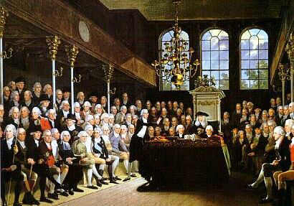
The American colonists wanted some type of representation in the British Parliament in England if they were to be taxed.
Great Britain’s Parliament
© Rosie's Resources, LLC

Slide 9
The colonists sent a letter to King George III requesting to have representatives in Parliament.
Dear King George, lll
King George completely ignored their letter and their request.
© Rosie's Resources, LLC

Slide 10
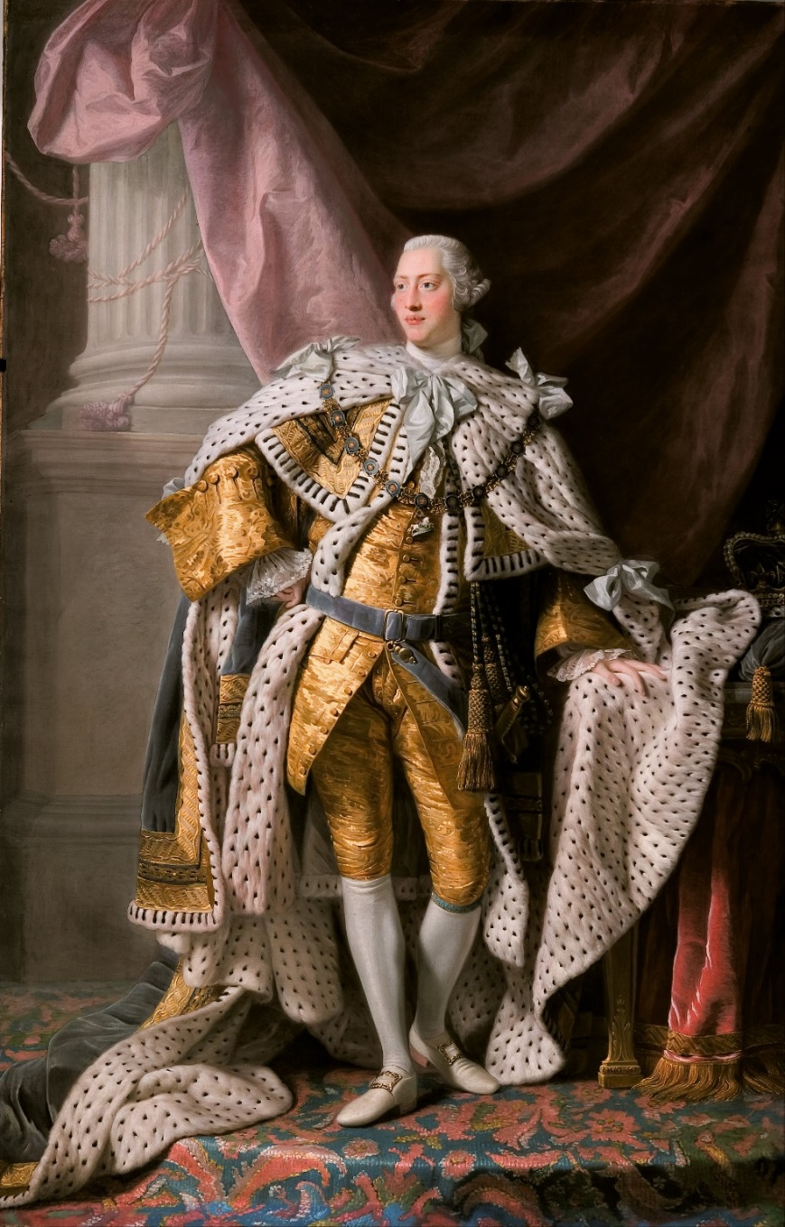
After 1764,
the British Government decided to impose new laws and more taxes. These new laws and taxes included
the Sugar Act
the Currency Act
the Quartering Act
the Stamp Act
the Townshend Acts
King George III, 1760 - 1801
© Rosie's Resources, LLC

Slide 11
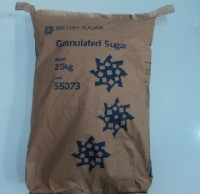
The Sugar Tax
The Sugar Act raised taxes on sugar and molasses. This tax was strictly enforced.
© Rosie's Resources, LLC

Slide 12
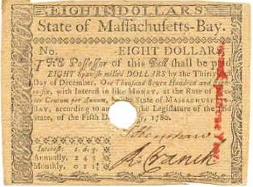
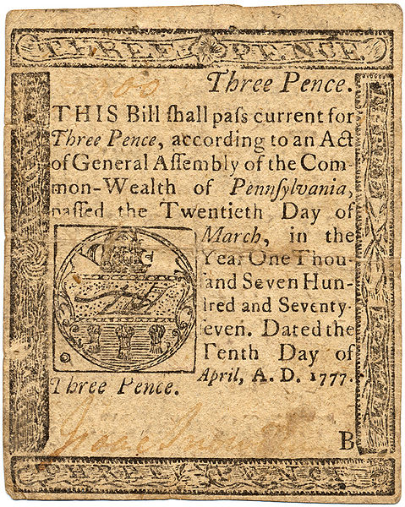
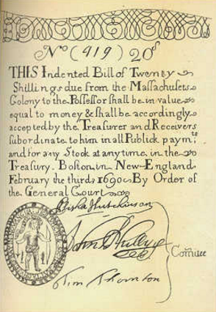
The Currency Act
The colonists tried to print their own money, but England passed the Currency Act. England now had complete control over the colonial monetary system.
Examples of currency from the 1700s
© Rosie's Resources, LLC

Slide 13
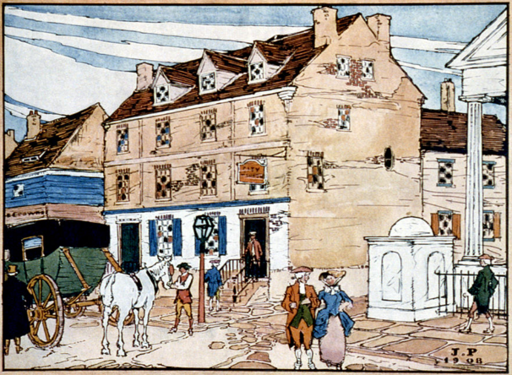
The Quartering Act
The colonists were forced to give British troops stationed in the colonies free food and shelter. The colonists often had to house the soldiers in their local inns, taverns and barns.
© Rosie's Resources, LLC

Slide 14
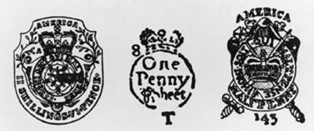
The Stamp Act
The Stamp Act affected all legal documents, magazines, playing cards, newspapers and many other types of printed materials. The documents had to be printed on special paper made in London.
Examples of stamps embossed on paper to show the tax had been paid
© Rosie's Resources, LLC

Slide 15
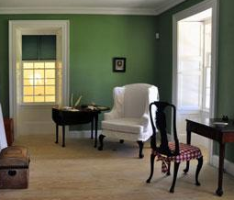
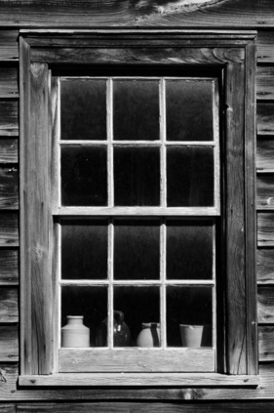
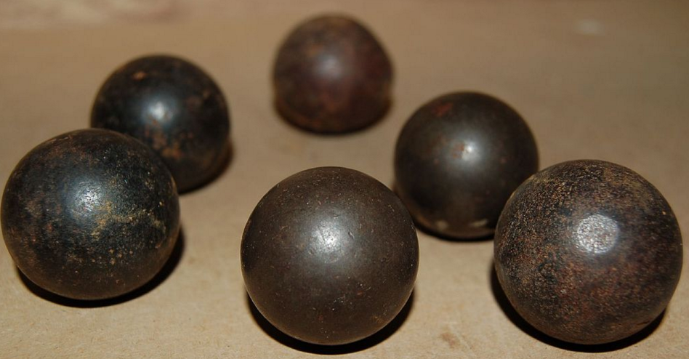
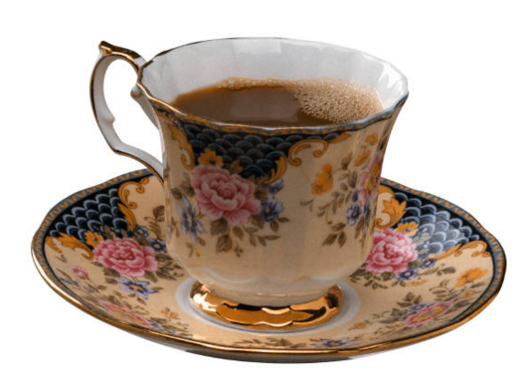
The Townshend Acts
The Townshend laws placed new taxes on glass, lead, paint and tea.
glass
paint
lead musket balls
tea
© Rosie's Resources, LLC

Slide 16
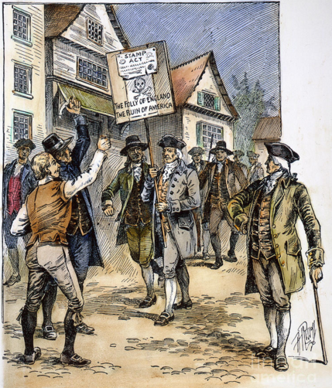
The Sons of Liberty
The colonists formed a secret organization called the Sons of Liberty. This group marched and protested taxation by the British government. They dumped three shiploads of tea into the Boston Harbor.
Procession in New York in opposition to the Stamp Act
© Rosie's Resources, LLC

Slide 17
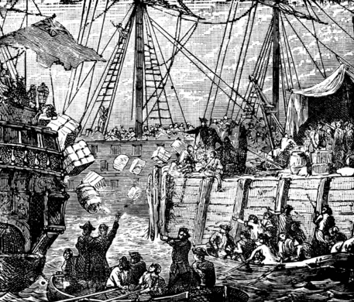
Boycotts
In protest, colonists boycotted English tea. American colonists in Philadelphia and New York turned tea ships back to Britain. In Charleston, the tea cargo was left to rot on the docks. In Boston, three shiploads of tea were dumped into the Harbor. This became known as the
Boston Tea Party.
The Boston Tea Party
© Rosie's Resources, LLC

Slide 18
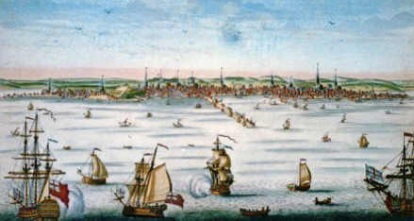
The Boston Blockade
Boston Harbor in the mid 1770s
England shut down the Boston Harbor in response to the Boston Tea Party. This punished both the American rebels, and also people loyal to England. The colonies united and sent supplies to the people of Boston.
© Rosie's Resources, LLC

Slide 19
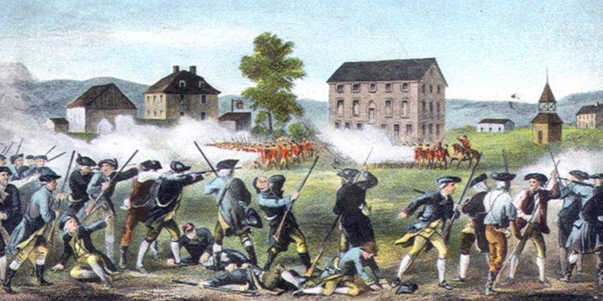
The Revolutionary War Begins
In 1775, when British troops were sent to confiscate a cache of weapons from the colonists, the colonists fought back and won. That first shot at Lexington came to be known as the The Shot Heard Round the World. It gave the colonists confidence to fight the war ahead.
The Battle of
Lexington, Massachusetts
© Rosie's Resources, LLC

